Slide 1
Getting the most out of AdWords

Slide 2
Jarek Rozynski
10+ years in marketing, including stints at Capital One, Vodafone & Google.
Recently started RozNix, a digital advertising agency that helps companies optimize their online marketing efforts.

Slide 3
AGENDA
Why AdWords?
Search
Display
Mobile

Slide 4
What is a key challenge for SMBs?
1
Competitor down the street?
Target market awareness?

Slide 5
If market awareness is the primary challenge, what is the solution?
GETTING FOUND

Slide 6
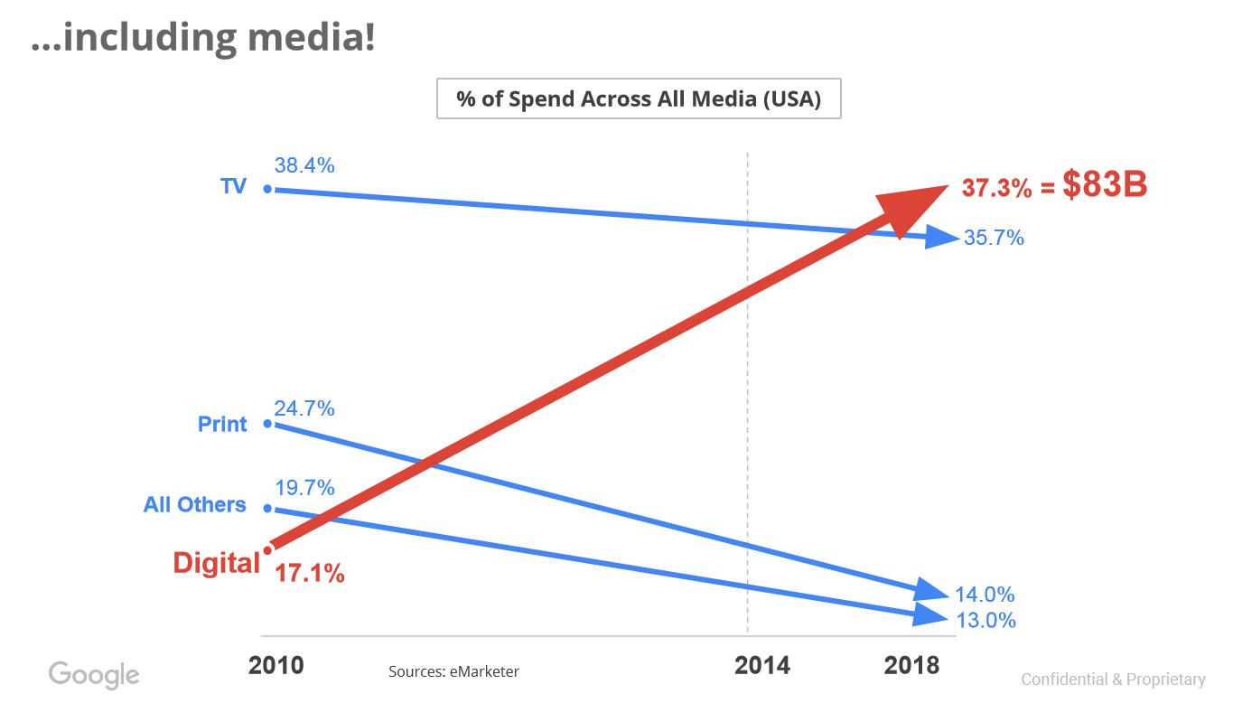
Digital to dominant marketing spend

Slide 7
Google AdWords – Main Benefits
Reach | Massive usage (88% Canada; 65% USA)
Relevance | Your ad is seen only by prospects who are looking for what you have to offer
ROI | Pay per click model ensures that you are paying for qualified leads
Tracking | Ability to track user behaviour easily and in detail. This leads to further optimization.

Slide 8
Search
1
Structuring An Account For Success

Slide 9
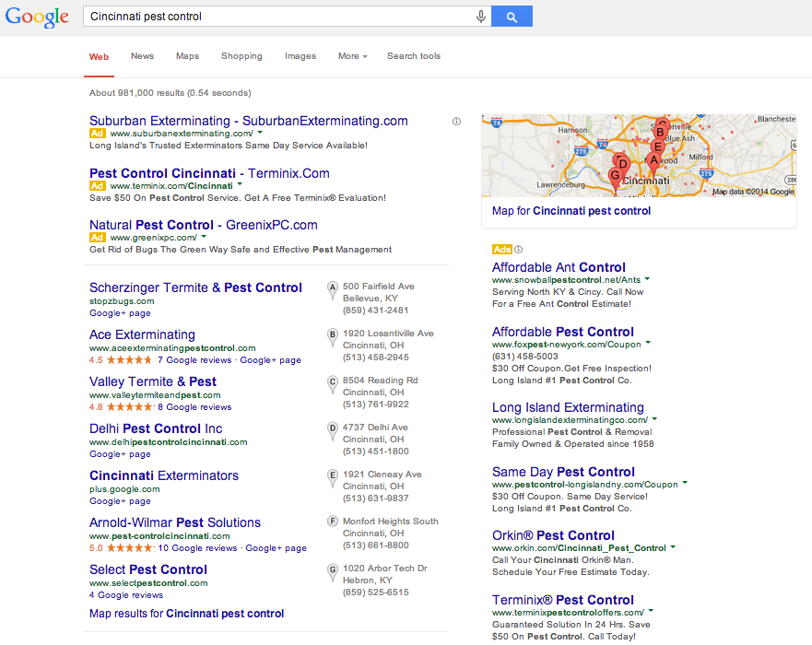
Search Query
Paid Results
\
Organic Results
Structuring An Account For Success

Slide 10
Creating an AdWords Campaign
Budget
Geographic targeting (including radius)
Language
Device (desktop, tablet or mobile)
Time of day; day of week
Age/Gender (brand new)
Keywords
Bids

Slide 11
Keyword match type
Match Type | Special Symbol | Example Keywords | Ads may show on searches that | Example Searches
Broad | none | women's hats | Any word in any order - misspellings, synonyms, related searches, and other relevant variations | Ladies shoes
Broad Match Modifier | +keyword | +women's +hats | Same as Broad but must contain keyword with + symbol in front of it | Ladies fedora
Phrase | "keyword" | "women's hats" | Are a phrase and close variation of that phrase | buy women's hats
Exact | [keyword] | [women's hats] | Are an exact terms and close varitions of that exact term | women's hats
Negative | -keyword | -cheap | Are searches without the term | Cheap women’s hats

Slide 12
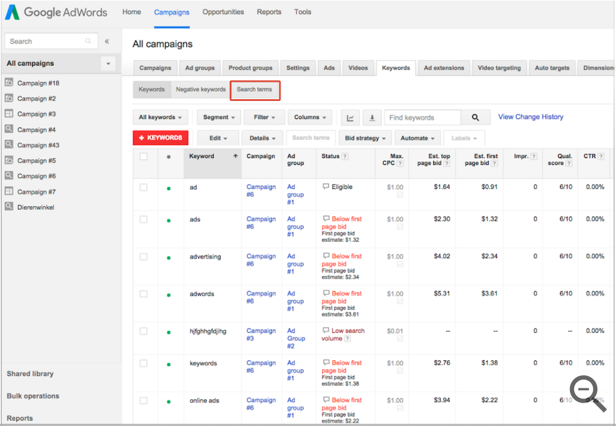
Search Terms Report
This report tells you exactly what people who saw your ads were searching for.

Slide 13
How are AdWord’s ads ranked?
1
Ad Rank
Maximum CPC bid
Quality Score
Ad extensions impact
=
+
+

Slide 14
What contributes to Quality Score?
Quality Score is an estimate of how relevant your
ads, keywords, and landing page are to a person seeing your ad
Quality Score
Keyword & Ad Quality
Site Quality
Keyword CTR (Largest factor)
Ad text relevance
Historical Performance
Load time and navigability
Transparency
Relevance

Slide 15
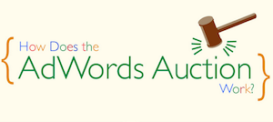
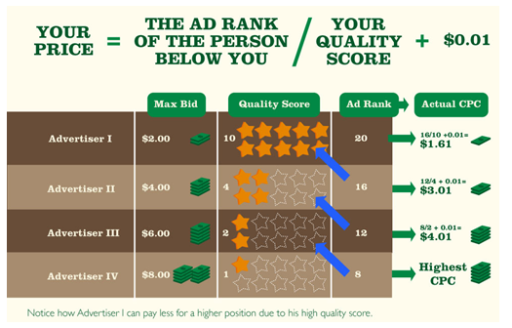
Does not show

Slide 16
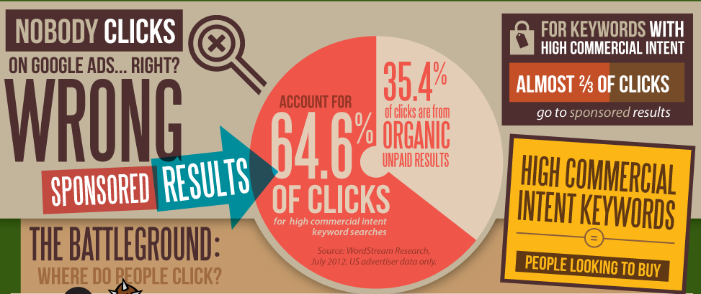
Nobody clicks on Google Ads? Think again
1

Slide 17
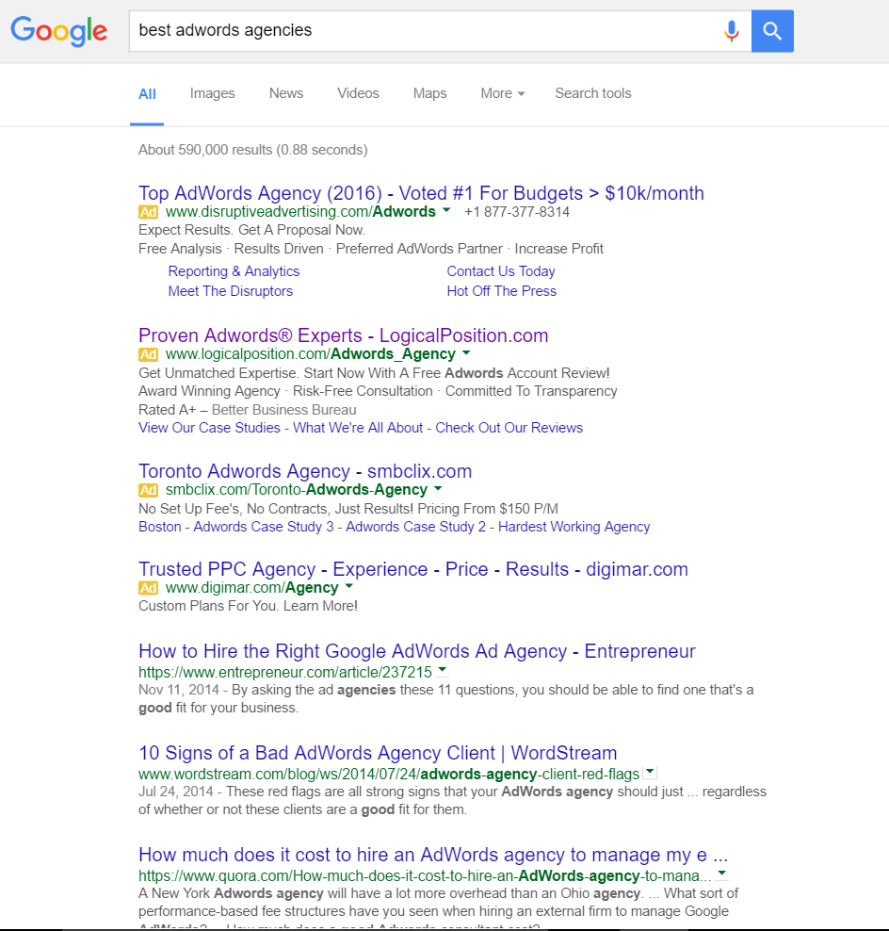
PAID
ORGANIC

Slide 18
How to measure effectiveness of your campaign
Conversions
View-through Conversions (Display campaigns only)
Clickthrough Rate (CTR)
Setting up conversion tracking is crucial to understand how clicks lead to a desired site action (e.g. sales, leads, phone calls, app downloads).
VTCs measure assist conversions, where a customer sees - but doesn’t click - a display ad before converting on your site.
If you are unable to implement conversion tracking, use CTR to see how campaigns are driving traffic.

Slide 19
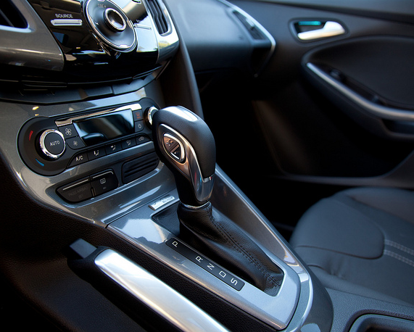
Manual vs automatic bidding
Two ways to manage your bids
manual
automatic

Slide 20
Manual Bids allows for most control, but is labour intensive.
Max CPC | Bid Modifiers
Set how much you’re willing to pay for each click to your website. Campaigns in which you want to drive as much web traffic as possible within your CPC limit. | Set % modifiers on your existing bids based on your target criteria. Apply modifiers to your targeting criteria (such as device, time of day, location) to raise or lower bid on that specific segment.

Slide 21
Automated Bids for best performance
Enhanced CPC | Target CPA | Target ROAS | Viewable CPM
Modifies bidding up to 30% to improve chance of conversions. Campaigns in which you want to meet CPC goals and improve the chance of conversions. | Modifies bidding to improve chance of conversions. Needs 15 conversions last 30 days. Campaigns in which you want to automate bidding. | Modifies bidding to improve value of conversions. Needs 15 conversions last 30 days. Campaigns in which you want to automate bidding and have a concrete ROI target. | Modifies bidding to favor ad slots that are more likely to become viewable Campaigns in which you want to maximize ad views, rather than clicks

Slide 22
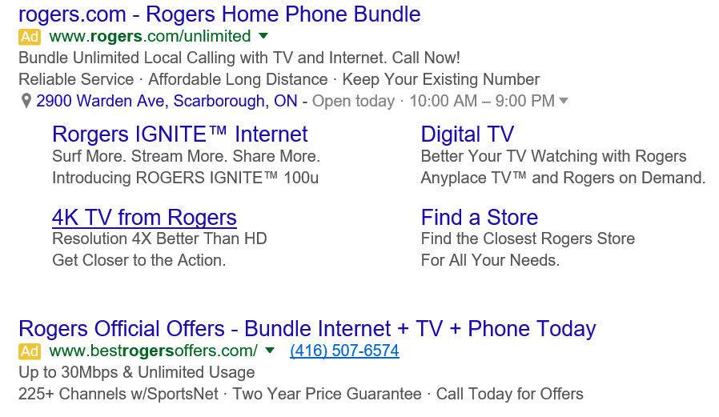
Ad Extensions
Callout
Show valuable information to potential customers before they click on your ad.
Location
Highlights a business location. They allow customers to instantly get directions.
Sitelink
Link to additional information from your site within your search ads so they can get where they want to go faster.
Call
Allow customers to easily find a phone number, and on mobile devices, call directly from your ad.

Slide 23
DISPLAY
1
Structuring An Account For Success

Slide 24
How to connect with consumers when they aren’t searching?
79%
of time online is spent outside search
21%
of time online is spent searching

Slide 25
Google Display Network allows you to reach over 90% of global internet users and is based on real time audience behaviour.
Source: ComScore, July 2013

Slide 26
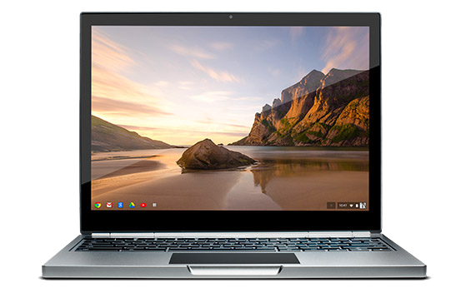
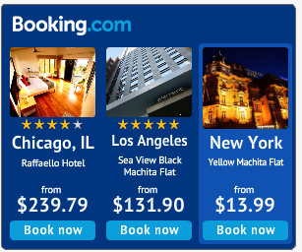
Types of display creatives
Text ads
Image ads

Slide 27
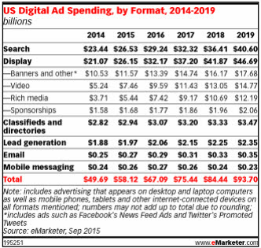
Display ad spend surpasses search this year in the US

Slide 28
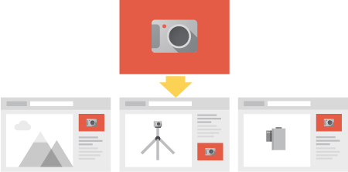
Keyword Contextual Targeting
Use keywords to show ads to people who are visiting or have visited websites with content that’s contextually relevant to those keywords.

Slide 29
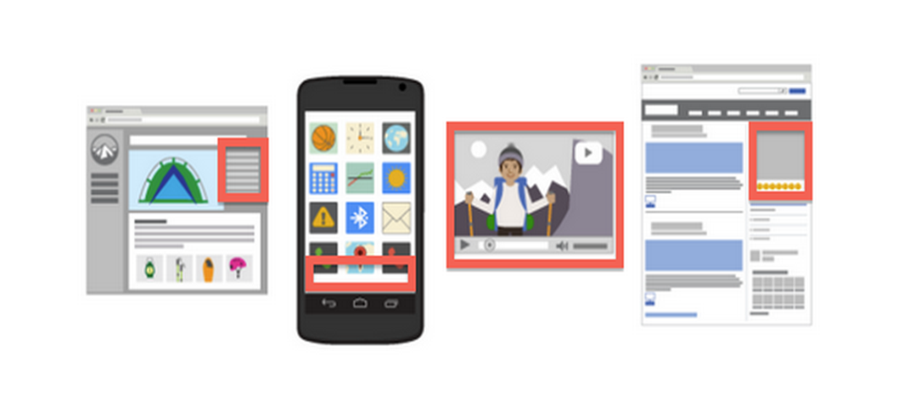
Placement Targeting
Placements are locations on the Google Display Network where your ads can appear, like a website or a specific page on a site or a mobile app.

Slide 30
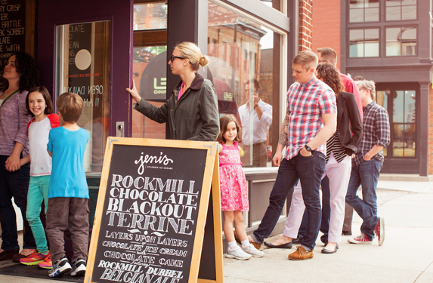
Demographic Targeting
Focus on specific regions or audiences that fit demographic profiles.
Age Demographics
Gender Demographics
Parental Status

Slide 31
Topic Targeting
Gives you the ability to place ads on website pages relating to specific topics. These specific topic categories are generated by Google.
Event Planning
Dyes & Pigments
Consulting
Automotive Industry
Home Office
Network Security
Cold & Flu
Doctors’ Offices
Business News
File Sharing & Hosting
Real Estate Listings
Astronomy
Auctions
Luxury Goods
College Sports
Car Rental

Slide 32
Affinity Targeting
Designed based on traditional TV targeting to help you find the right interest audience quickly. Choose from a number of preselected categories based on user actual behaviour.
Beauty Mavens
Family Focused
Foodies
Gamers
Health Buffs
Movie Lovers
Political Junkies
Sports Fans
Outdoor Enthusiasts
Thrill Seekers
Travel Buffs
Auto Enthusiasts
Do-It-Yourselfers
Luxury Shoppers

Slide 33
In-Market Audiences
Google utilizes sophisticated algorithms, including signals like site content, frequency and recency, to differentiate “interest” from “intent” in real time and serve ads to users close to conversion.
Apparel and Accessories
Autos & Vehicles
Baby & Children’s Products
Consumer Electronics
Computers & Peripherals
Consumer Software
Education
Employment
Financial Services
Gifts & Occasions
Home & Garden
Real Estate
Telecom
Travel

Slide 34
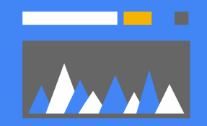
Display Remarketing
By adding a piece of code across your website, you can create user lists of people who are visiting your site. You can later connect with these potential customers while they search on Google or browse other websites.
Combine with data from Google Analytics for better targeting based on user behaviour on site.

Slide 35
Similar Audiences
Based on your remarketing list, Google looks at browsing activity to understand shared interests and characteristics of users visiting your site. Using this information, they automatically find new potential customers who have similar interests to your site visitors.

Slide 36
Reaching your perfect audience
Mix and match targeting types to find your exact consumers
Demographics:
Show ads based on age and gender
Interest Categories: Show ads based on inferred interests
Geography: Show ads on based on city or state
Placements: Show ads on websites that you select
Topics: Show ads on sites that cater to specific topics

Slide 37
MOBILE
1
Structuring An Account For Success

Slide 38
The Mobile Revolution is already here
* In 10 countries including US and Japan
Source: Searchengineland.com

Slide 39
Mobile has surpassed desktop
in Canada

Slide 40
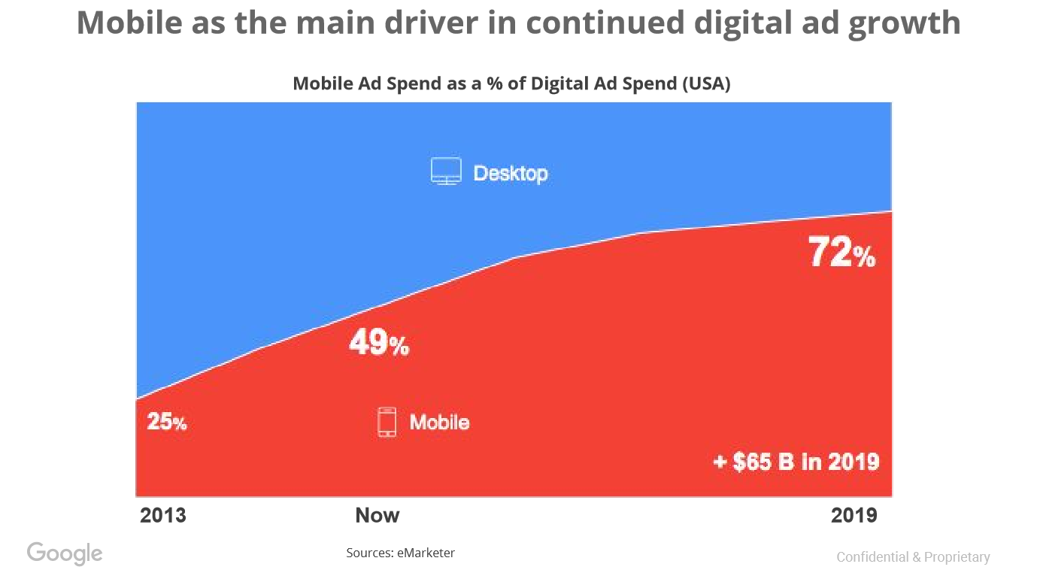

Slide 41
1
Structuring An Account For Success

